Slide 1


SENTIMENT MINING OF AMAZON PRODUCT REVIEWS
CMPE-256 Term project
Under the Guidance of – Prof M.Eirinaki
Team Senti-Map - GitHub
Mrinmayi Gavali(012431588)
FNU Aprajita(012489074)
Priyanka Kumar(013749866)

Slide 2


DATASET
PROBLEM SOLVED
8.9 M Records
Size: 10 GB
Predict User Sentiment Using Reviews
Recommend items to users
22 M Records
Size: 874 MB

Slide 3

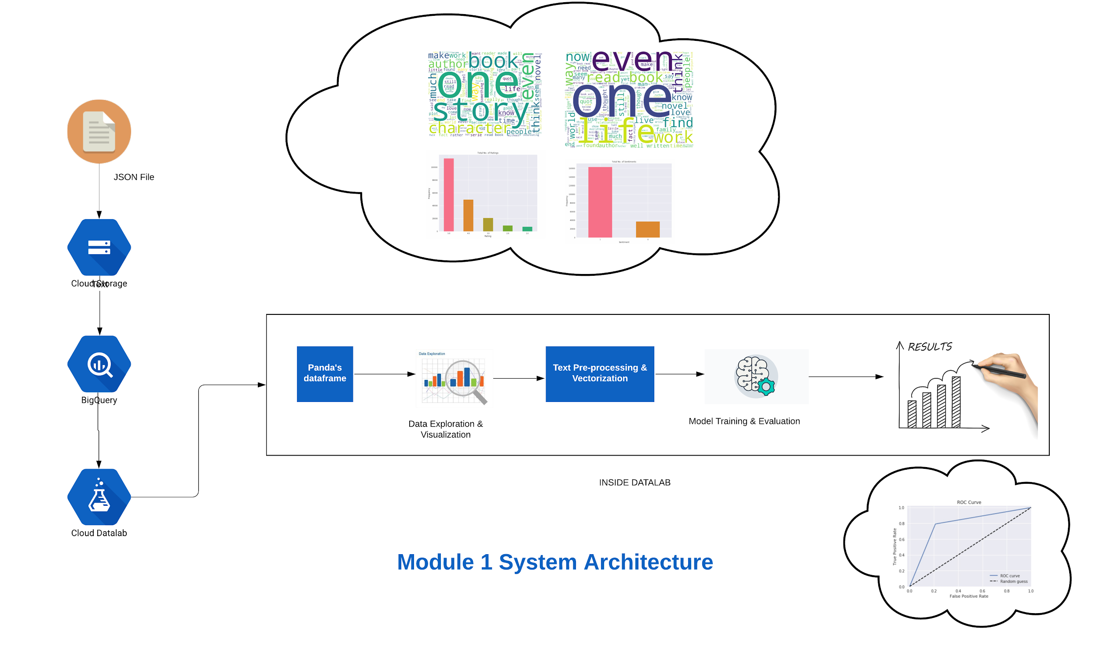
ARCHITECTURE - 1

Slide 4
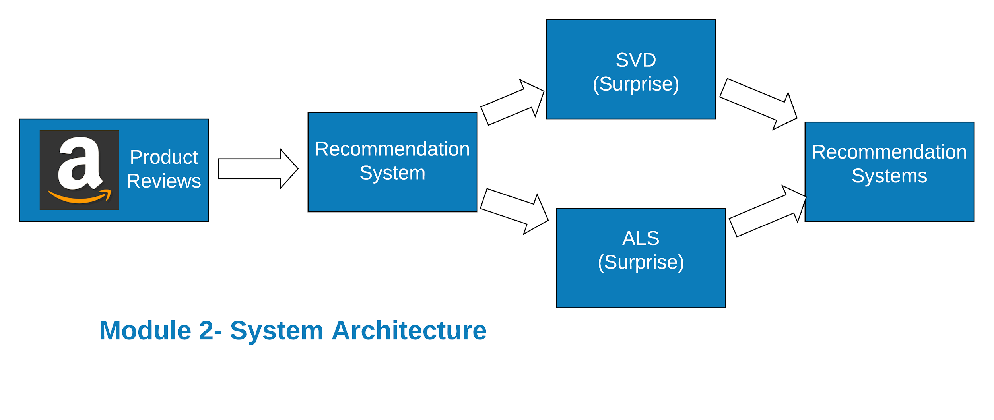
ARCHITECTURE - 2

Slide 5
SOLUTIONS
SENTIMENT ANALYSIS
Text- Processing
TF-IDF
Classification
RECOMMENDER SYSTEM
Singular Value Decomposition
Alternating Least Squares

Slide 6
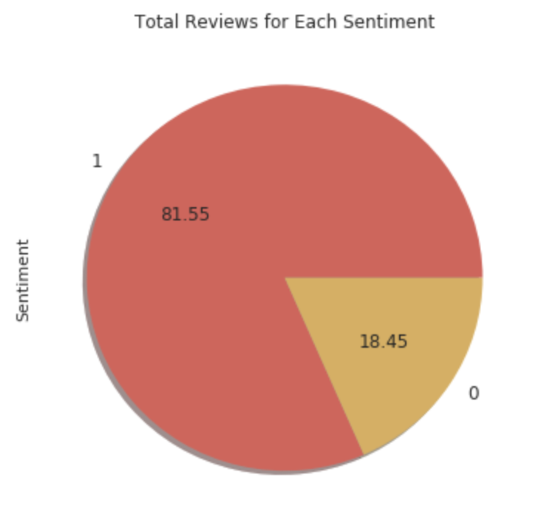
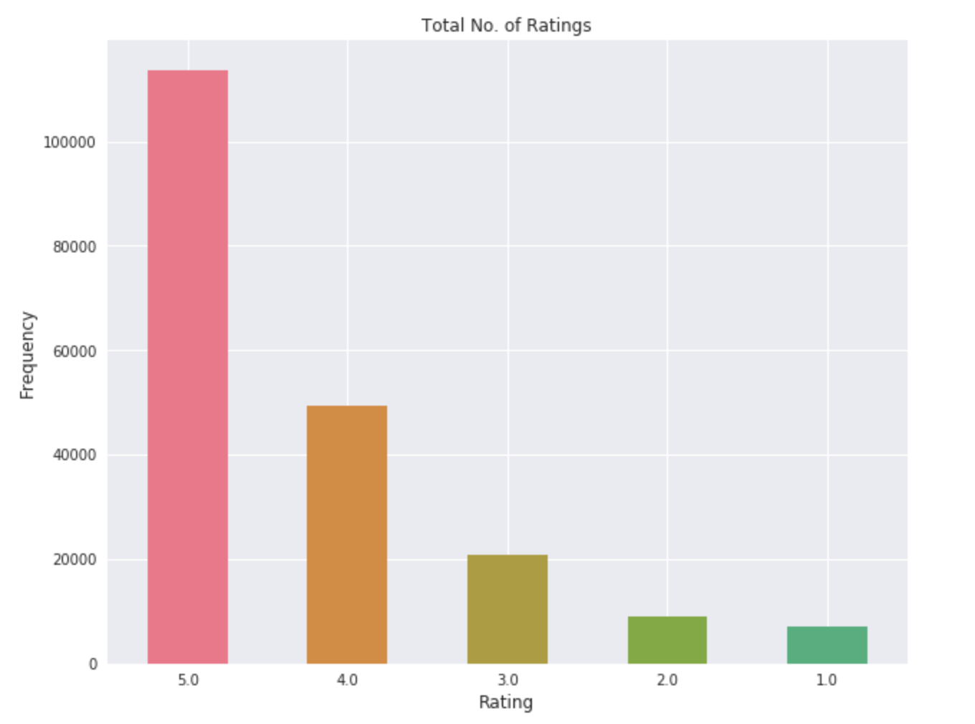
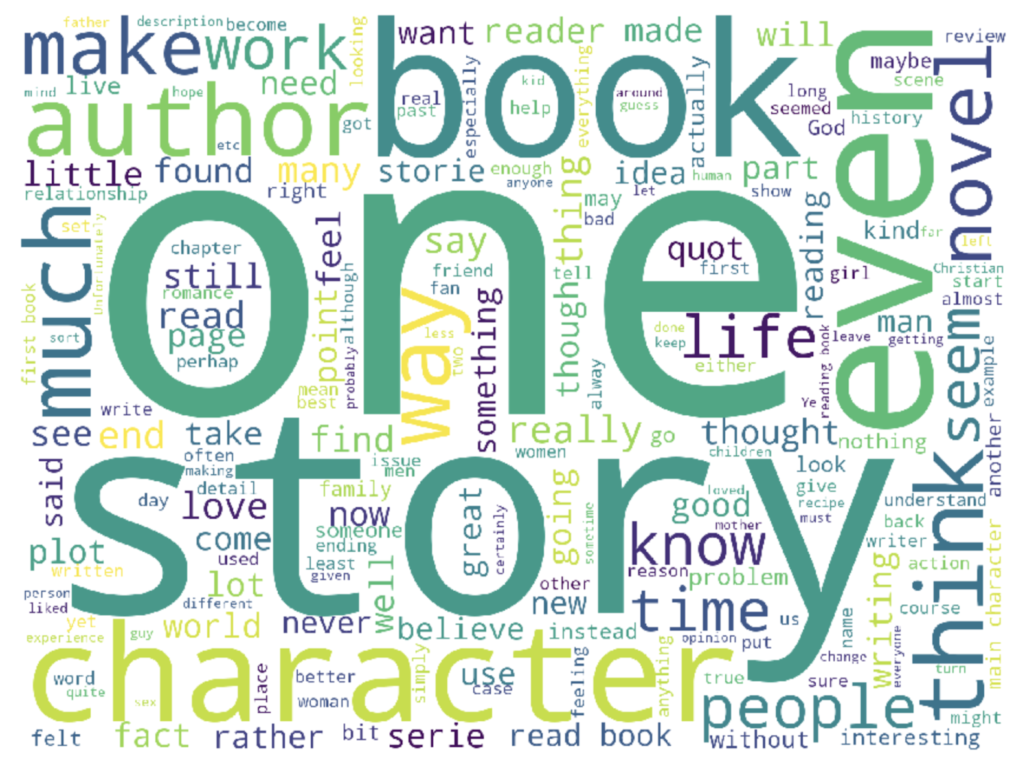
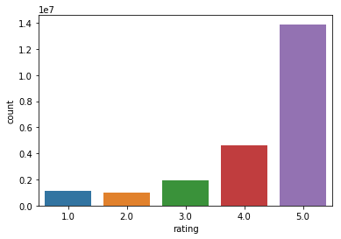
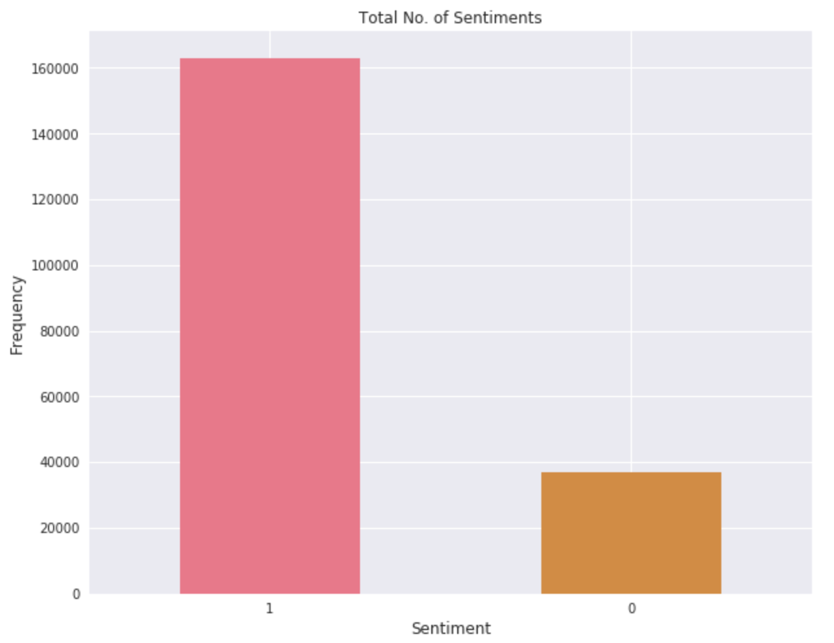
VISUALIZATIONS

Slide 7
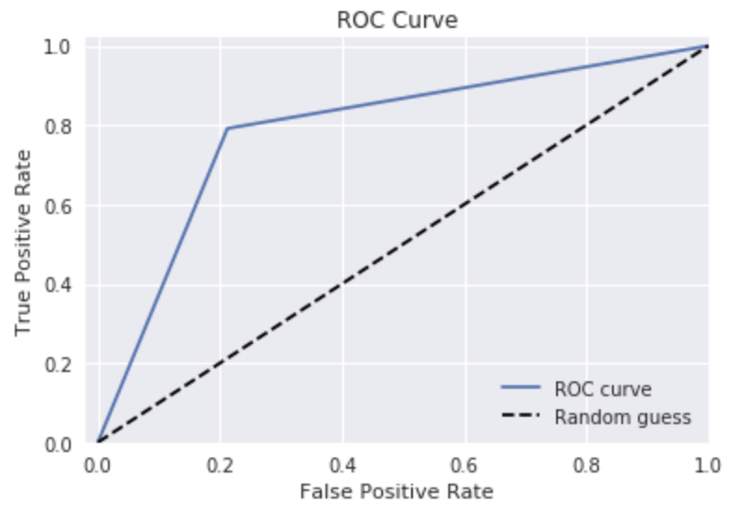
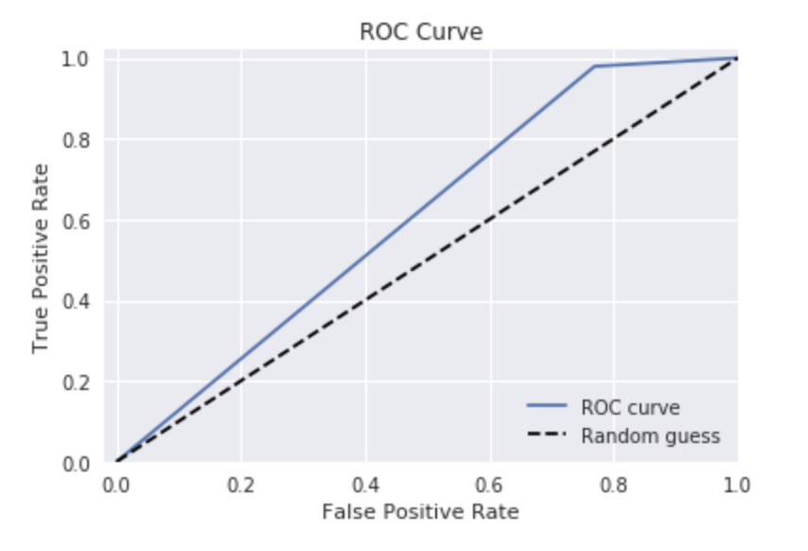
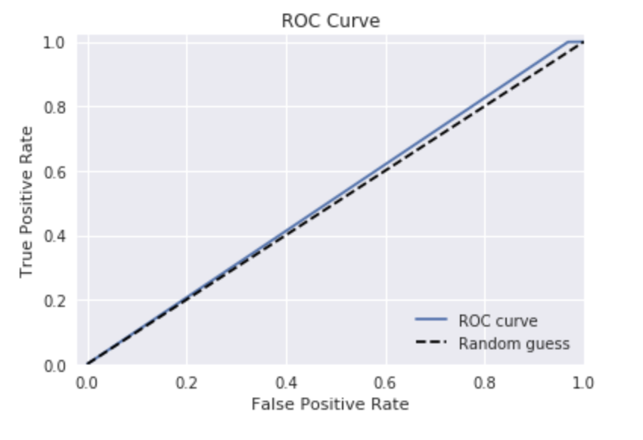
EVALUATIONS & RESULTS
ROC Curve for Logistic Regression
ROC Curve for Random Forests
ROC Curve for Multinomial
Naive Bayes

Slide 8
CONCLUSIONS
Module 1
Very large dataset
Imbalanced Dataset
Inconsistent Google Datalab session
Data Visualization, Word Cloud, Text-Clustering, Model Training & Evaluations
Module 2
Google Colab crashed for dataset > 1M
Faced issues while implementing Apache Spark
ALS & SVD both performed well for sample size of 1M
ALS was faster on dataset size of 10M

Slide 9


